Slide 1

Prediction of Student Earnings
Arindam Samanta
Bellevue University
MS-DSC

Slide 2
Business Problem / Background
Data Collection and Cleaning
Data Visualization
Target values and feature importance
Gradient Boosting Model
Random Forest Regressor
Conclusion
Challenges and Ethical Assessment
References and Acknowledgement

Slide 3
Business Problem / Background
Question: What college factors lead to successful students?
Some Definitions:
College
A four-year Institution
Status of College = Operating (Pvt/State)
Predominantly Bachelors Degree
Factors
Admission rate, school ownership
School selectivity (SAT/ACT Scores)
Retention / Completion Rate
Full-Time faculty rate, Average faculty earnings
Success
Students’ mean earnings (6 & 10 years after entry)

Slide 4
Data Collection and Cleaning
Finding the Metrics
School
School Name, Ownership
Faculty rate, Faculty Salary
Student
Retention Rate
Completion
Completion Rate
Admissions
Admission rate
SAT Score
Earnings
Student median earnings 6 yrs after entry
Student median earnings 10 yrs after entry
Data Cleaning
Removed rows with null values
Binned data on certain values to study trends based on specific range of values
Grouped data by specific metrics and performed aggregated calculations
Data cleansing codes used are pandas specific like dropna(), groupby(), sort_values, style_format()

Slide 5
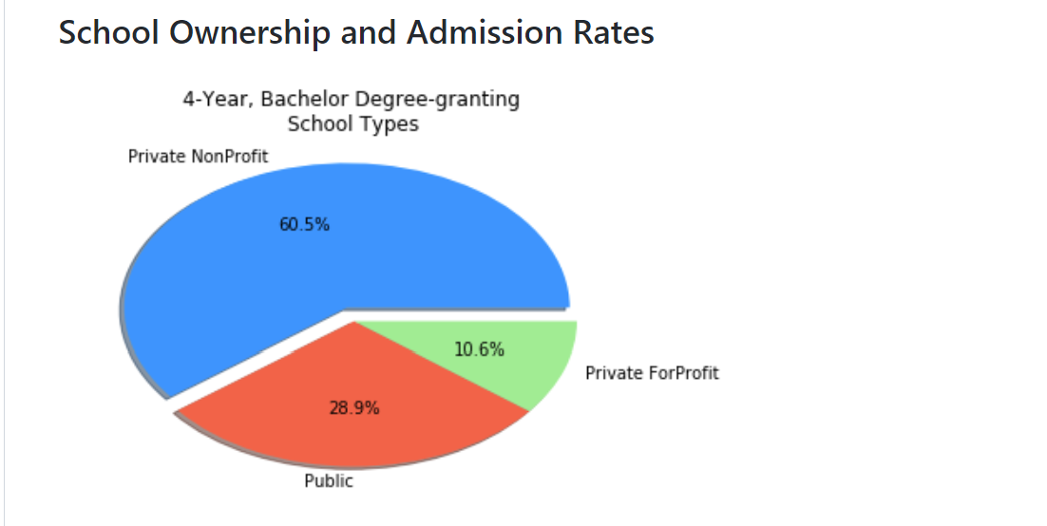
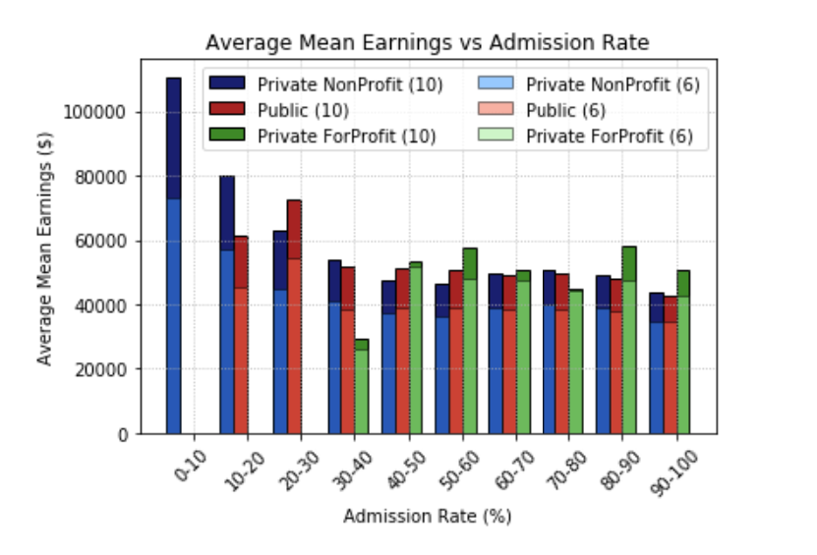
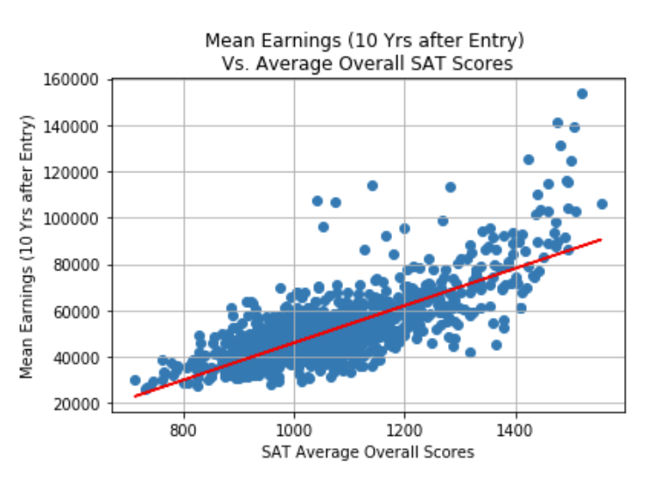
Data Visualization
By comparing admission rates(%) against mean earnings($), the more difficult to get accepted the more higher earnings
Private Non Profit colleges are by far the largest set of colleges giving 4 yr bachelor degrees
The above scatter plot indicates that avg SAT scores has a positive correlation with mean eranings(10 yrs after entry)

Slide 6
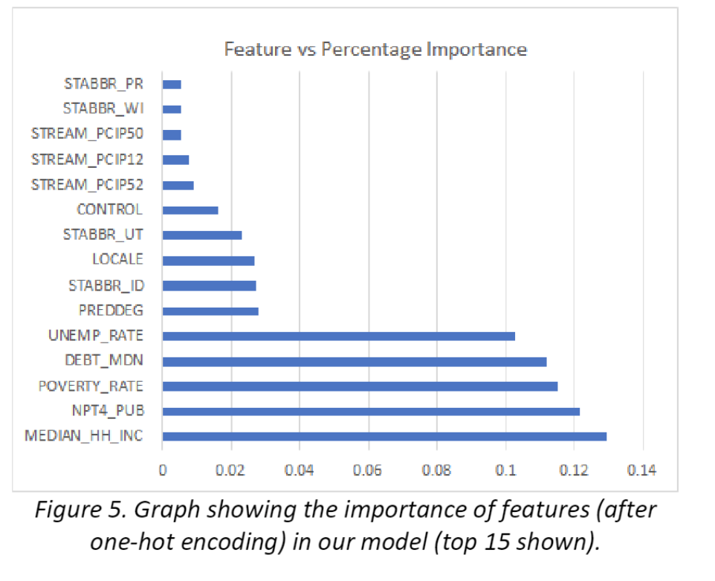
Target values and feature importance
Target Values
Median earnings after 6 years
Median earnings after 8 years
Median earnings after 10 years
Used ‘gini importance’ or the mean decrease impurity of the features
It is defined as the ratio between the number of splits that include the feature to the number of samples split by the feature averaged over all the trees.

Slide 7
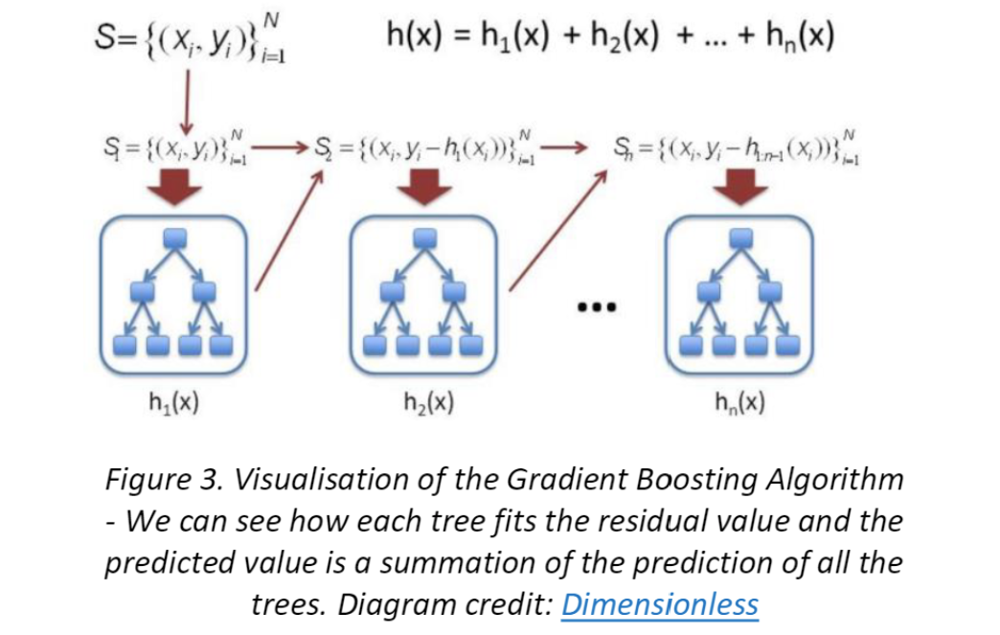
Gradient Boosting Model
I decided to use Least Absolute Deviation for the Loss function
The residuals are calculated based on the loss function
1900 trees were built sequentially
Decision tree regressor is built
Previous model output is used for the next model
A learning rate of 0.1 is chosen
For a perfect model prediction I summed up values by each tree.

Slide 8
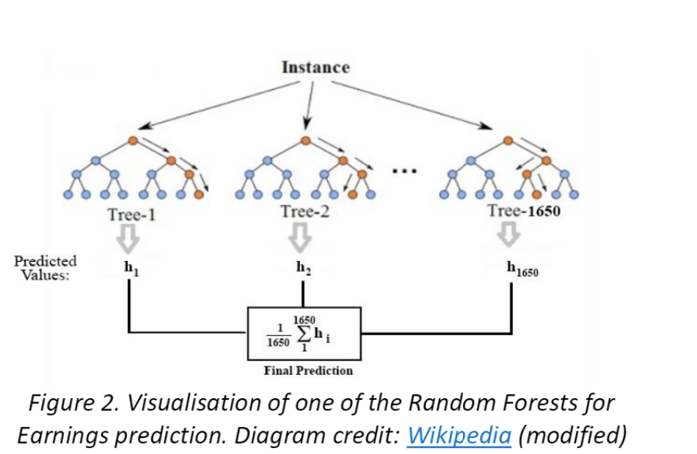
Random Forest Regressor
1650 Decision tree regressors are built before aggregating
Predictions became better with the number of estimators increased
I decided to set a minimum value for samples that the leaf requires.
I decide to use the previous model or solution to speed up the learning process

Slide 9
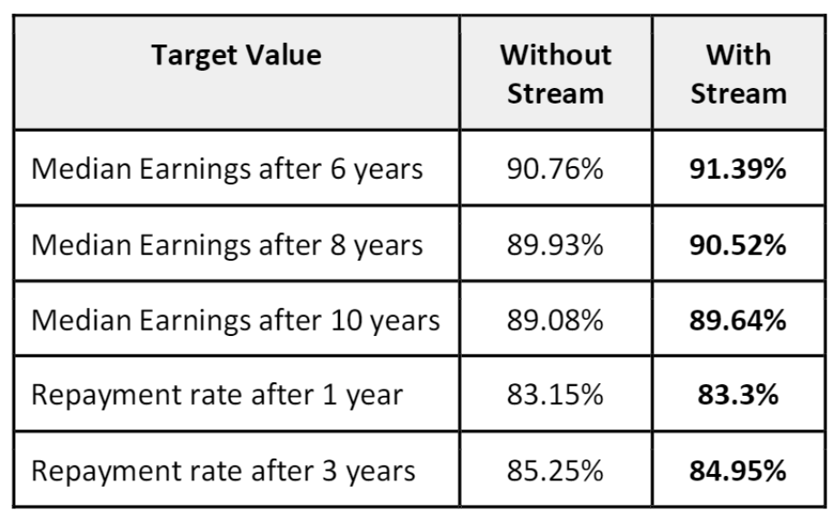
Conclusion
This project is able to help students learn more about:
how they are shaping their future
how they would be able to repay back their loans

Slide 10
Challenges and Ethical Considerations
Data quality issues e.g., some sectors had high shares of students with an unknown completion status
Data suppression in order to protect student privacy
Data hidden and not available for analysis
The missing elements were as a result of no compulsory or mandatory clause for reporting and as a result inaccuracy of the report cannot be ruled out.

Slide 11
References and Acknowledgement
References And Acknowledgements:
Finally I would like to acknowledge Bellevue University for giving me this opportunity to present this academic project for the 2022 academic year as part of our MS Data Science course(MS DSC 680).
Additionally I would like to thank our Professor Fadi Alsaleem for his expert advice and guidance. Lastly I would also like to thank my class mates for continuous support and encouragement.
Book Ref
https://collegescorecard.ed.gov/data/
https://www.usnews.com/education/best-colleges/articles/how-us-news-calculated-the-rankings
https://www.usnews.com/education/best-colleges/paying-for-college/articles/how-students-should-use-new-college-scorecard-data
https://community.tibco.com/wiki/college-scorecard-analysis
https://www.kaggle.com/datasets/kaggle/college-scorecard
https://deepnote.com/@omar-khan/Analysis-of-COLLEGESCORECARD-dataset-VG7JYdzUTDOOFv003pRAVw

